Slide 1

Python 1441032 (11-12)
הרצאה#2: : 1. מפעילים לוגיים - and, not, or.
2. בקרת מבני זרימה (if, while, for).
3. מיתרים, זוגות, רשימות (Strings, Tuples, Lists).
4. המשך: איטרציות, לולאות וזרימת בקרה.
5. תוסף: הקלד המרות (Type conversions)
Lesson 2 by A.Abraham Ariel University, Spring 2020

Slide 2
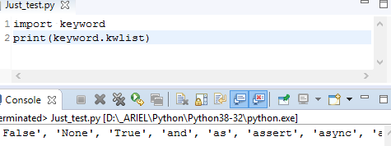
יסודות השפה: מילות מפתח, משתנים, מפעילים, מבני נתונים בסיסיים, פונקציות.
>>> import keyword >>> print(keyword.kwlist)
['False', 'None', 'True', 'and', 'as', 'assert', 'break', 'class', 'continue', 'def', 'del', 'elif', 'else', 'except', 'finally', 'for', 'from’, 'global', 'if', 'import', 'in', 'is', 'lambda', 'nonlocal', 'not', 'or', 'pass', 'raise', 'return', 'try', 'while', 'with', 'yield']
✓ False, None, True, and, not, or
✓ as, assert,
✓ def, lambda, return,
✓ if, else, elif,
✓ for, while, in, break, continue,
✓ global, nonlocal,
try, except, raise, finally,
class, pass,
del, from, import, is, with, yield,
async, await.

Slide 3
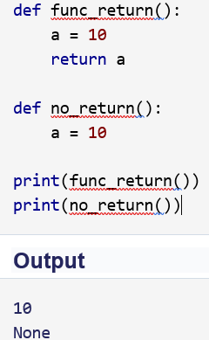


יסודות השפה: מילות מפתח Python Keywords: def, lambda, return
def is used to define a user-defined function. Function is a block of related statements, which together does some specific task. It helps us organize code into manageable chunks and also to do some repetitive task.
return statement is used inside a function to exit it and return a value.
lambda is used to create an anonymous function (function with no name). It is an inline function that does not contain a return statement. It consists of an expression that is evaluated and returned.

Slide 4






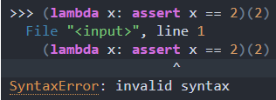

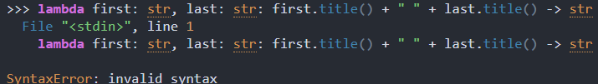
Lambda functions = anonymous functions
https://realpython.com/python-lambda/
https://realpython.com/python-f-strings/

Slide 5
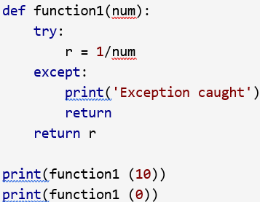
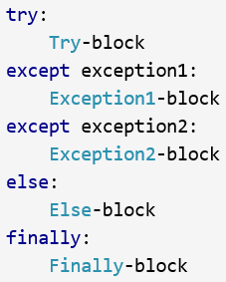

יסודות השפה: מילות מפתח Python Keywords: try, except, raise, finally,
except, raise, try are used with exceptions in Python. Exceptions are basically errors that suggests something went wrong while executing our program. IOError, ValueError, ZeroDivisionError, ImportError, NameError, TypeError etc. are few examples of exception in Python. try ... except blocks are used to catch exceptions in Python.
We can raise an exception explicitly with the raise keyword.
finally is used with try…except block to close up resources or file streams. Using finally ensures that the block of code inside it gets executed even if there is an unhandled exception.

Slide 6
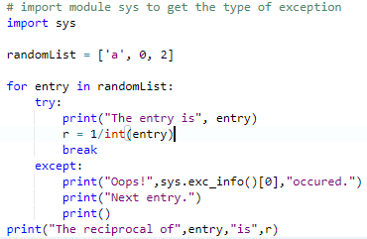
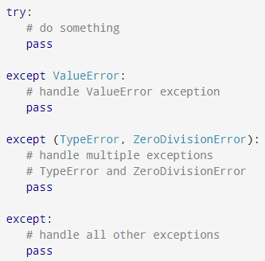
Exceptions (continued 1)
1) Simple Exceptions
2) Catching Specific Exceptions

Slide 7
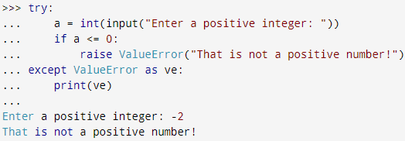
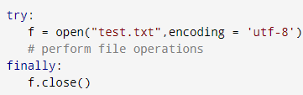
Exceptions (continued 2)
Raising Exceptions
try...finally

Slide 8




imp
יסודות השפה: מילות מפתח Python Keywords: from, import
What are modules in Python? Modules refer to a file containing Python statements and definitions. A file containing Python code, for e.g.: example.py, is called a module and its module name would be example.
import keyword is used to import modules into the current namespace. from…import is used to import specific attributes or functions into the current namespace.
Now we can use the cos() function inside it as math.cos().
if we wanted to import just the cos() function, this can done using from
now we can use the function simply as cos(), no need to write math.cos().
>>> sys.path >>> dir();
imp.reload(~a~module~name)
https://www.programiz.com/python-programming/modules

Slide 9
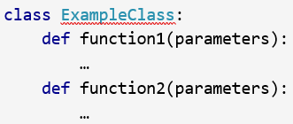


יסודות השפה: מילות מפתח Python Keywords: class, pass
class is used to define a new user-defined class in Python.
Class is a collection of related attributes and methods that try to represent a real-world situation. This idea of putting data and functions together in a class is central to the concept of object-oriented programming (OOP).
Classes can be defined anywhere in a program. But it is a good practice to define a single class in a module.
Pass is a null statement in Python. Nothing happens when it is executed. It is used as a placeholder.

Slide 10
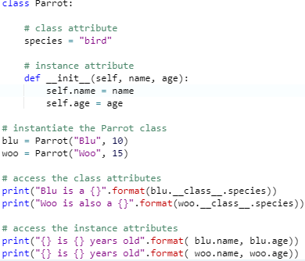
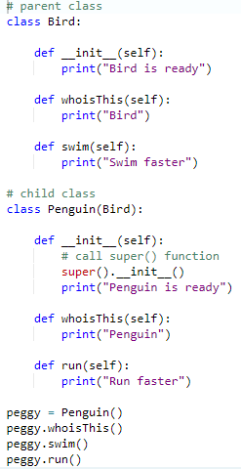
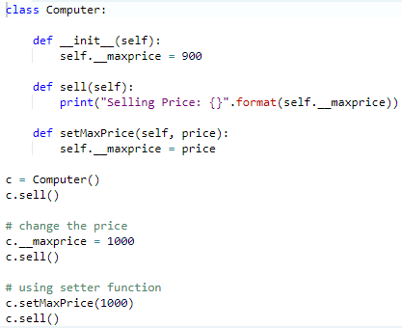
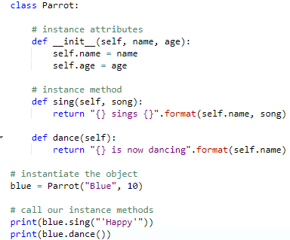
OOP
Class & object
Inheritance - ירושה
encapsulation - כימוס
https://he.wikibooks.org/wiki/%D7%A4%D7%99%D7%99%D7%AA%D7%95%D7%9F/%D7%A4%D7%99%D7%99%D7%AA%D7%95%D7%9F_%D7%92%D7%A8%D7%A1%D7%94_3/%D7%9E%D7%97%D7%9C%D7%A7%D7%94

Slide 11
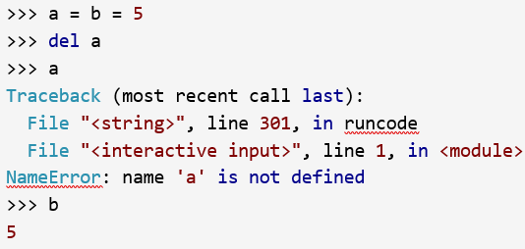
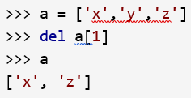
יסודות השפה: מילות מפתח Python Keyword: del
Everything is object in Python. del is used to delete the reference to an object.

Slide 12
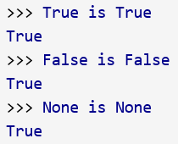
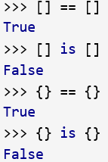
יסודות השפה: מילות מפתח Python Keyword: is
is - is used in Python for testing object identity. While the == operator is used to test if two variables are equal or not, is is used to test if the two variables refer to the same object. It returns True if the objects are identical and False if not.

Slide 13
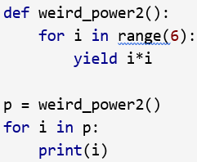
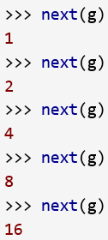

יסודות השפה: מילות מפתח Python Keyword: yield
yield is used inside a function like a return statement. But yield returns a generator. Generator is an iterator that generates one item at a time. A large list of value will take up a lot of memory. Generators are useful in this situation as it generates only one value at a time instead of storing all the values in memory.
This type of generator is returned by the yield statement from a function.

Slide 14
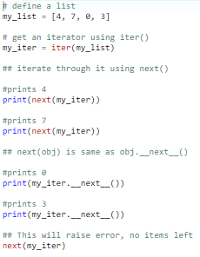
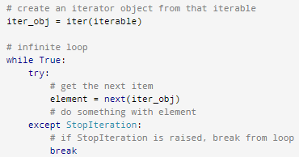
Iterator: class with __iter__() and __next__()

Slide 15

יסודות השפה: מילות מפתח Python Keyword: with
with statement is used to wrap the execution of a block of code within methods defined by the context manager. Context manager is a class that implements __enter__ and __exit__ methods. Use of with statement ensures that the __exit__ method is called at the end of the nested block. This concept is similar to the use of try…finally block.

Slide 16
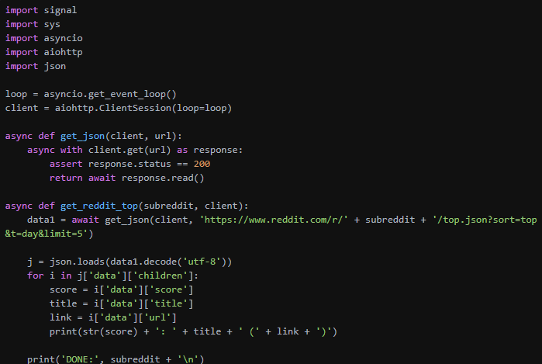
יסודות השפה: מילות מפתח Python Keywords: async, await
https://docs.python.org/3/library/asyncio-task.html
async def ping_local():
return await ping_server('192.168.1.1’)
async def ping_server(ip): # ping code here...

Slide 17
Assignments
EX1
If we list all the natural numbers below 10 that are multiples of 3 or 5, we get 3, 5, 6 and 9. The sum of these multiples is 23.
Find the sum of all the multiples of 3 or 5 below 1000.
EX2:
Ask the user for a number. Depending on whether the number is even or odd, print out an appropriate message to the user. Hint: how does an even / odd number react differently when divided by 2?
Extras:
If the number is a multiple of 4, print out a different message.
Ask the user for two numbers: * a number to check /variable/ * a number to divide by /dividor/. If dividor divides evenly into variable, tell that to the user. If not, print a different appropriate message.

Slide 18


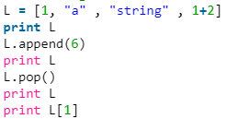


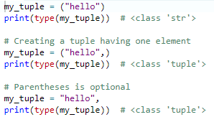
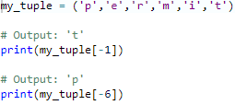

מחרוזות, זוגות, רשימות
Strings, Tuples, Lists -
A string is a sequence of characters. It can be declared in python by using double quotes. Strings are immutable.
A list can contain strings, integers, as well as objects. Lists can also be used for implementing stacks and queues. Lists are mutable, i.e., they can be altered once declared.
A tuple is a sequence of immutable Python objects. Tuples are just like lists with the exception that tuples cannot be changed once declared. Tuples are usually faster than lists.

Slide 19
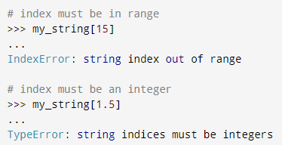
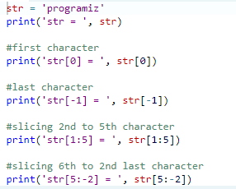
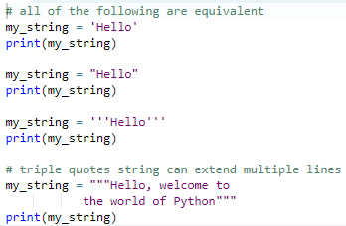
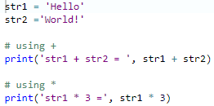


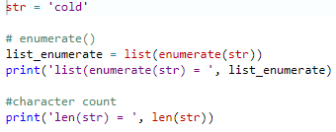
שורות
We cannot delete or remove characters from a string. But deleting the string entirely is possible using the keyword del.
enumerate() and len()

Slide 20
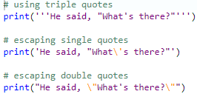
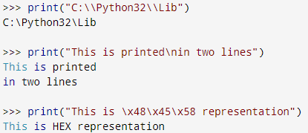
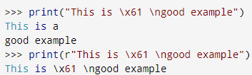
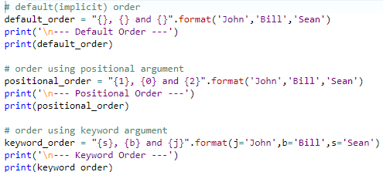

שורות (המשך)
String Formatting פירמוט מחרוזות -
lower(), upper(), join(), split(), find(), replace(), …

Slide 21
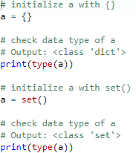
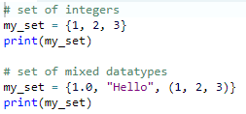
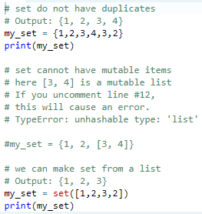
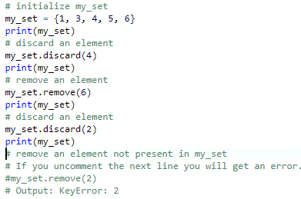
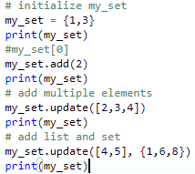
Sets - סטים
A set is an unordered collection of items. Every element is unique (no duplicates) and must be immutable. However, the set itself is mutable. We can add or remove items from it.
To make a set without any elements we use the set() function without any argument.

Slide 22
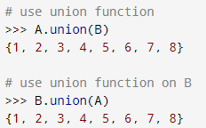
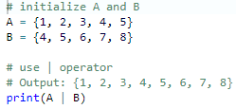
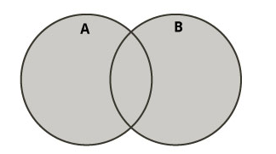
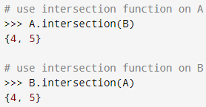

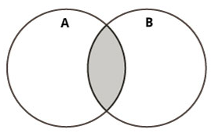
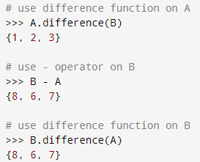
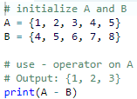
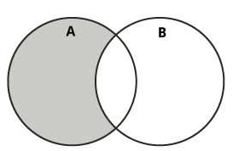
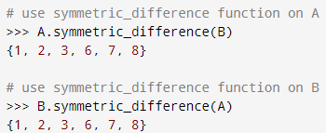


Set Operations

Slide 23
Sets Methods
Method | Description
add() | Adds an element to the set
clear() | Removes all elements from the set
copy() | Returns a copy of the set
difference() | Returns the difference of two or more sets as a new set
difference_update() | Removes all elements of another set from this set
discard() | Removes an element from the set if it is a member. (Do nothing if the element is not in set)
intersection() | Returns the intersection of two sets as a new set
intersection_update() | Updates the set with the intersection of itself and another
isdisjoint() | Returns True if two sets have a null intersection
issubset() | Returns True if another set contains this set
issuperset() | Returns True if this set contains another set
pop() | Removes and returns an arbitrary set element. Raise KeyError if the set is empty
remove() | Removes an element from the set. If the element is not a member, raise a KeyError
symmetric_difference() | Returns the symmetric difference of two sets as a new set
symmetric_difference_update() | Updates a set with the symmetric difference of itself and another
union() | Returns the union of sets in a new set
update() | Updates the set with the union of itself and others

Slide 24

Sets functions
Function | Description
all() | Return True if all elements of the set are true (or if the set is empty).
any() | Return True if any element of the set is true. If the set is empty, return False.
enumerate() | Return an enumerate object. It contains the index and value of all the items of set as a pair.
len() | Return the length (the number of items) in the set.
max() | Return the largest item in the set.
min() | Return the smallest item in the set.
sorted() | Return a new sorted list from elements in the set(does not sort the set itself).
sum() | Return the sum of all elements in the set.
Frozenset:
Frozenset is a new class that has the characteristics of a set, but its elements cannot be changed once assigned. While tuples are immutable lists, frozensets are immutable sets.

Slide 25





Dictionaries
dictionary is an unordered collection of items. While other compound data types have only value as an element, a dictionary has a key: value pair.
Dictionaries are optimized to retrieve values when the key is known.
Function | Description
all() | Return True if all keys of the dictionary are true (or if the dictionary is empty).
any() | Return True if any key of the dictionary is true. If the dictionary is empty, return False.
len() | Return the length (the number of items) in the dictionary.
cmp() | Compares items of two dictionaries.
sorted() | Return a new sorted list of keys in the dictionary.

Slide 26




Python f-string
f-string is the newest Python syntax to do string formatting. It is available since Python 3.6. Python f-strings provide a faster, more readable, more concise, and less error prone way of formatting strings in Python.
The f-strings have the f prefix and use {} brackets to evaluate values.

Slide 27





F - String

